Slide 1

Cognitive Training Study

Slide 2
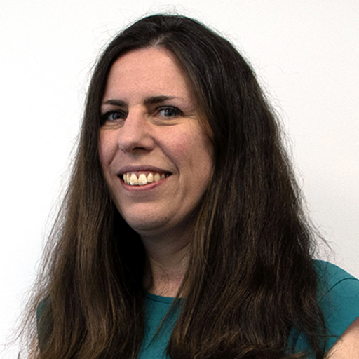
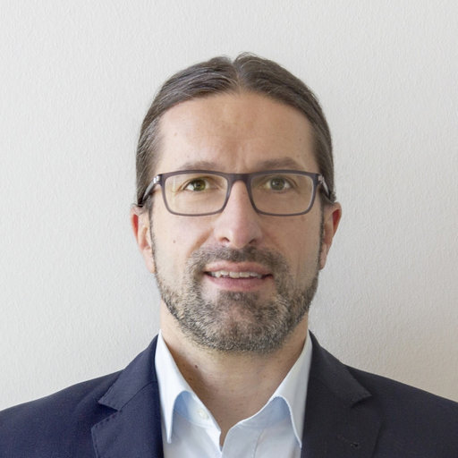


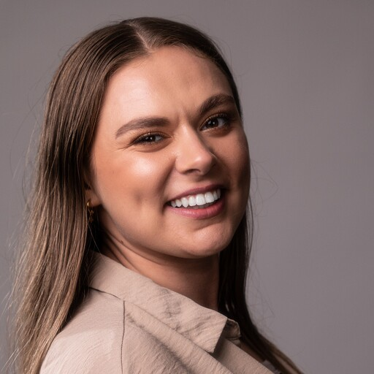
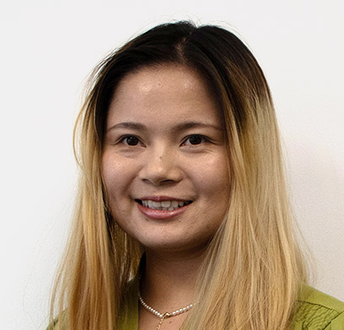





Cognitive Training
across the adult lifespan
Claudia von Bastian
Tilo
Strobach
Sylvie
Belleville
Alice Reinhartz
Eleanor
Hyde
Shuangke Jiang
Change in training and transfer tasks
Working memory, attentional control, reasoning, everyday cognition
Pretest
Posttest
Follow-Up
2 weeks
3 months
Training
Open Research Area VI
Individual differences
Predictors of cognitive abilities and change
Maintenance effects
Interventions with increasing attentional control demands
Simple RT (minimal)
Choice RT (low)
Switching (medium)
Dual task (high)
von Bastian et al. (2022), BMC Psychology

Slide 3
Participant Recruitment
Aim: N = 408 (to allow for attrition), n = 100 per condition across three sites, balanced age (18-85 years old) and gender spread.
Word of mouth
Posters
University of Sheffield Volunteering List - use wisely, you only get one shot!
Facebook Advertisements
Hamburg & Montreal used similar methods, with some notable differences (bank of older adults)

Slide 4
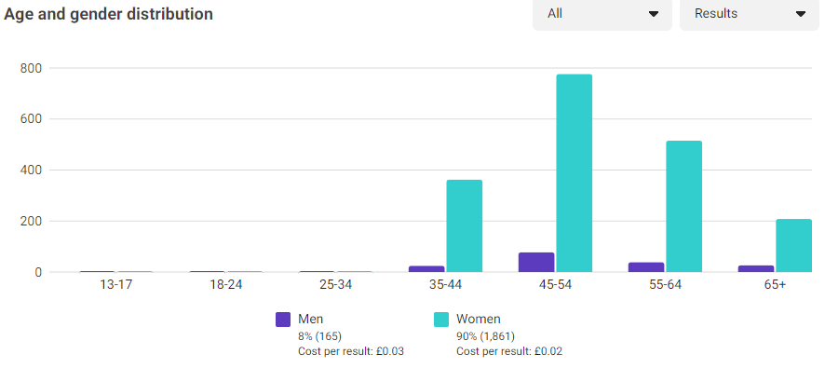
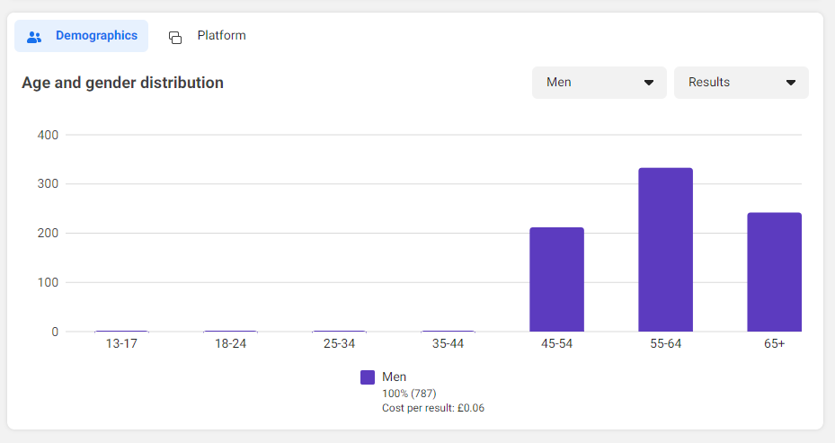
FB Ads Results
1 Week - Feb 2023
Targeted people in Sheffield City Centre (10k) aged 45+ years
Estimated audience size: 225,700 - 265,600
Link Clicks: 2,074
1 Week - April 2023
Targeted Men in Sheffield City Centre (10k) aged 45+ years
Estimated audience size: 69,200 - 81,500
Link Clicks: 787

Slide 5

Sample
Aim: N = 408 (to allow for attrition), n = 100 per condition across three sites, balanced age (18-85 years old) and gender spread.
Timeline: 1st June 2022 – 18th January 2024 1 Year, 7 months, 18 days
Simple
110
103
Choice
101
93
Switch
Dual
105
96
96
94%
92%
91%
102
94%
Total
418
93%
388
Sheff
Pretest
Retained
Follow-Up

Slide 6
Sample at follow-up/end of study
Total: N = 388 participants who completed at least 7 training sessions and follow-up assessment
Group | n | Age (years) | Range | Gender (w/m/o) | Education (years)
Simple RT | 103 | 48.77 (18.20) | 18 - 81 | 58/43/1 | 17.03 (3.89)
Choice RT | 93 | 47.42 (18.68) | 18 - 81 | 52/41/0 | 16.47 (3.75)
Switch | 96 | 50.13 (18.20) | 19 - 85 | 54/42/0 | 16.03 (3.69)
Dual | 96 | 48.08 (18.21) | 21 - 83 | 54/42/0 | 16.73 (3.23)

Slide 7
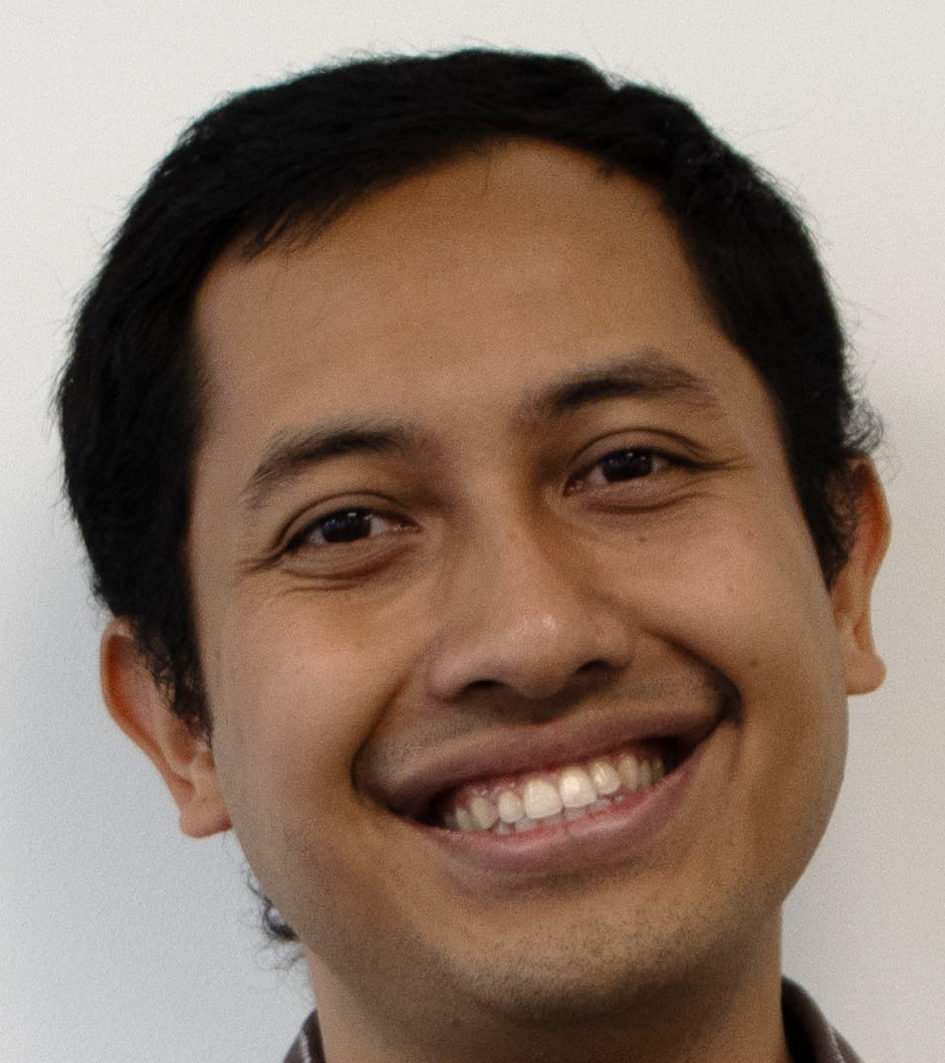
Helpful Factors for Retention
Built relationships with participants
Phone Screening
Pretest
Posttest
Follow-Up
Payment
Emails & Reminders

Slide 8
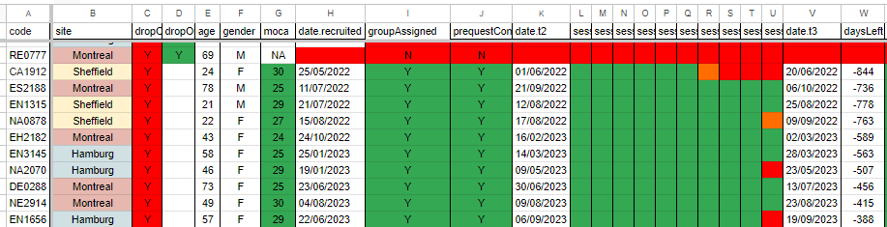
Helpful Factors for Retention
Built relationships with participants
Two Coordinators - one Coordinator ‘on-call’
Shared email address and Google Drive documents
Participant Tracker - checked training progress & rescheduled if they needed longer

Slide 9
Helpful Factors for Retention
Built relationships with participants
Two Coordinators - one Coordinator ‘on-call’
Shared email address and Google Drive documents
Participant Tracker - checked training progress & rescheduled if they needed longer
Handbook for Recruitment, Coordination and Testing – across sites
Voucher reward system increased based on completed participation
Paid for parking
Provide and Budget Tea, Coffee & Snacks
Ask participants how they found out about us

Slide 10

Video Game Studies

Slide 11
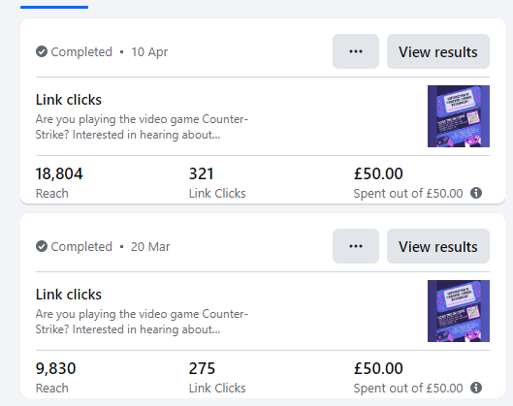
Recruitment Methods
Discord Channels – specific to Counter-Strike
Facebook Advertisements
Endpoint esports team
Gaming platforms i.e., FACEIT
Previous studies
CS player bank (N = 138)
Reddit
Share all over socials
In-person events i.e., LANs
68 Sign Ups
Who you know

Slide 12









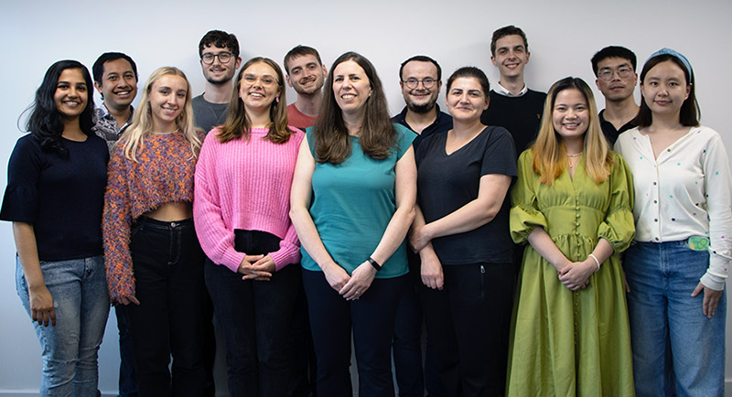
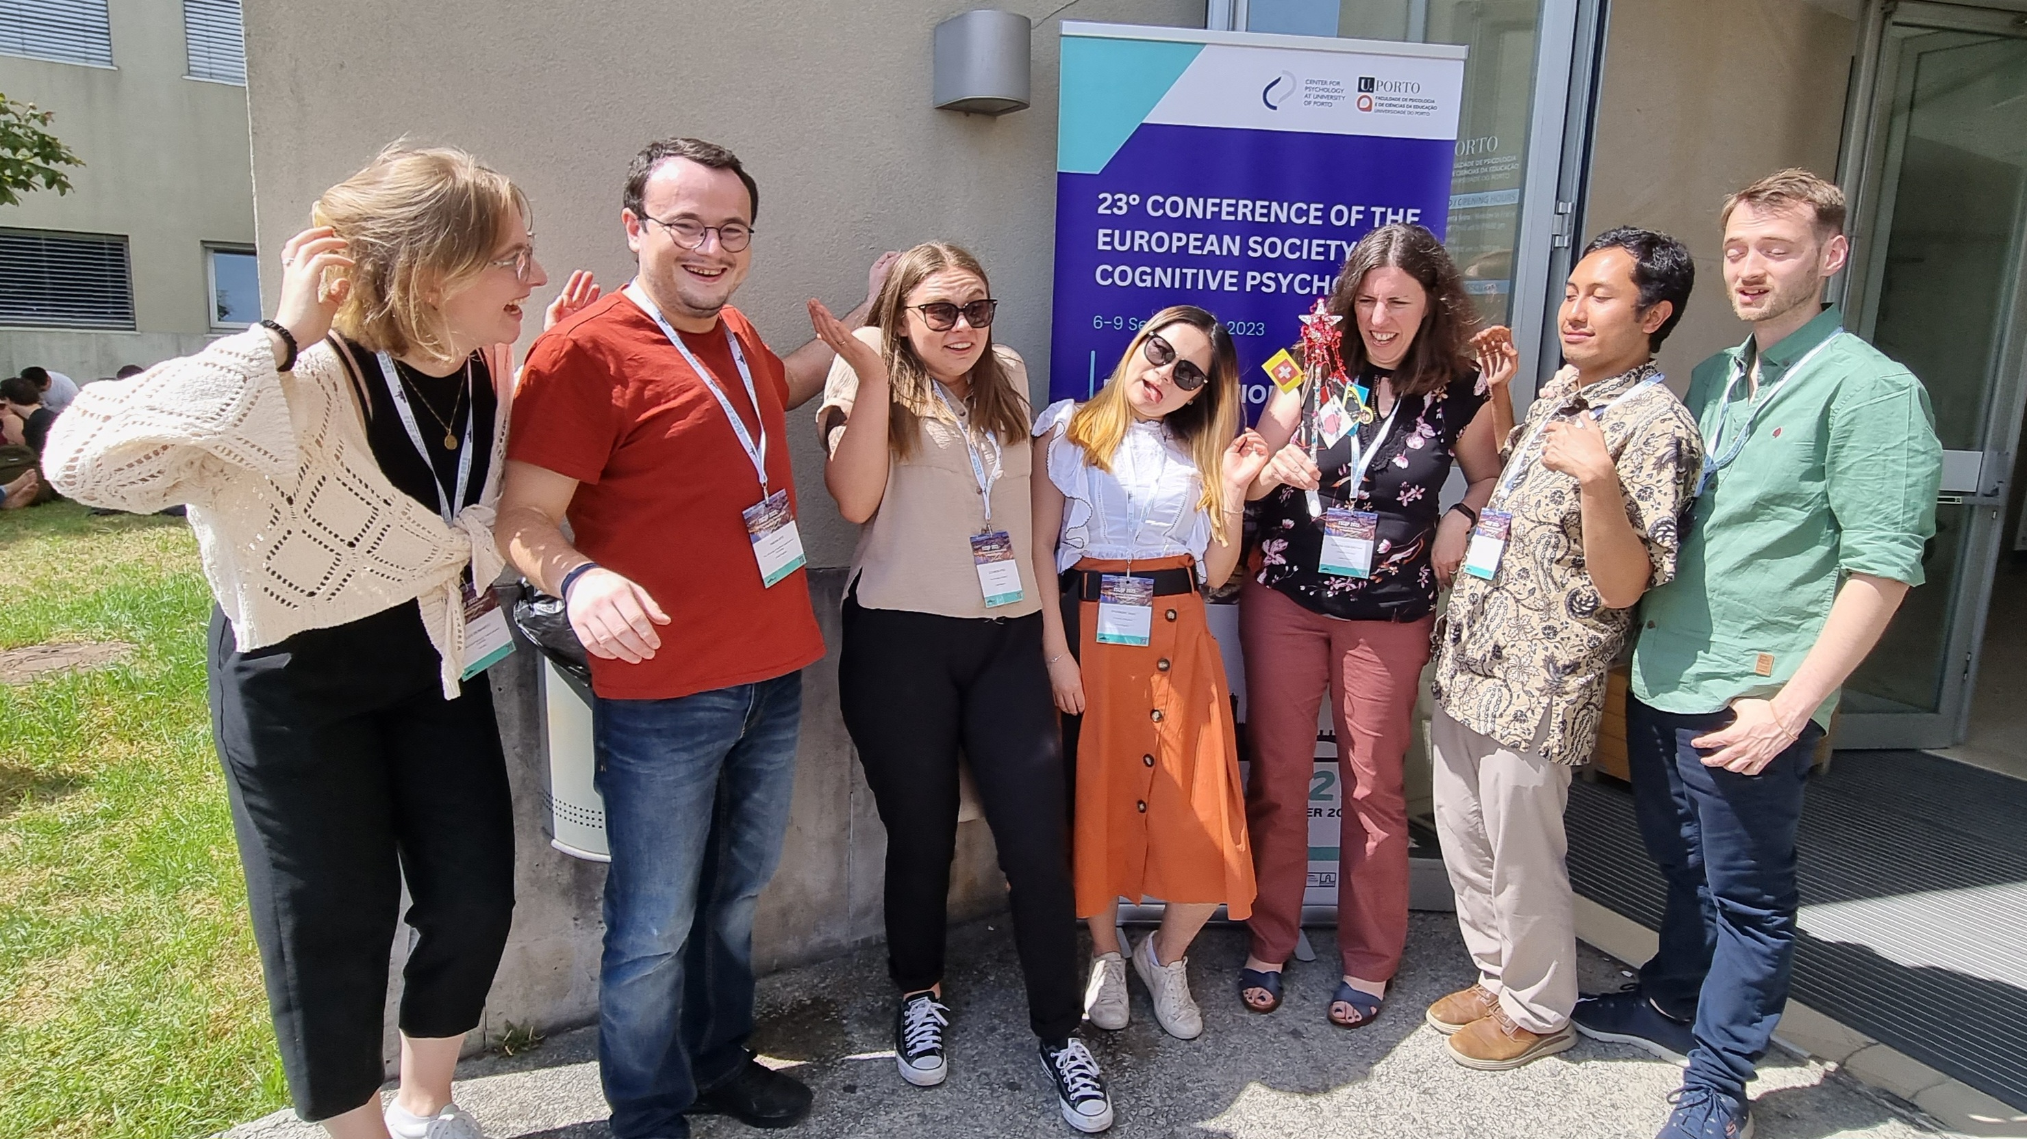
Cognitive Ability & Plasticity Lab
University of Sheffield
c.c.vonbastian@sheffield.ac.uk www.claudiavonbastian.com
@cvonbastian www.tatool-web.com
@cvonbastian.bsky.social

Slide 13



Sample at follow-up by site
Participants who completed at least 7 training sessions and follow-up
Hamburg
Montréal
Sheffield
N | 128 | 130 | 130
Age (years) M ± SD Range | 45.90 ± 17.25 yrs 19-81 | 49.92 ± 19.76 yrs 18-85 | 49.97 ± 17.54 yrs 18-78
Education (years) | 17.02 ± 3.51 yrs | 17.08 ± 3.45 yrs | 15.93 ± 3.96 yrs
Gender (w/m/o) | 78/49/1 | 75/55/0 | 65/64/0

Slide 14
Method
Pre-Assessment Questionnaires
Preregistered
Multi-site
Double-blinded
Actively controlled
Training at home
Week 1
2 Pretest Assessments
Randomization
Simple RT
Control
Experimental
Choice RT
Switch
Dual
Training and transfer gains
Working memory
Inhibition
Reasoning
Everyday cognition
Weeks 2 & 3
10 Training Sessions
Week 4
2 Posttest Assessments
3 Months Later
2 Follow-Up Assessments
von Bastian et al. (2022), BMC Psychology

